Slide 1
Comparing Runtimes of Python, R, and Matlab
Alexander Berliner, Mohamed Ibrahim, Kamaljeet Singh, Woody March-Steinman

Slide 2



Motivation
Context: Python, R, and Matlab - three popular programming languages used in statistics and data analysis.
Question: which one is fastest, overall?

Slide 3
Design
Factor: programming language → Python, R, and Matlab
Response: runtime
Controls:
Same computer running no background processes
Same, or as similar as possible, inbuilt functions and algorithms
Same data across all programming languages
Only measured the run-time of each task
Controllable nuisance factors: Data size and Programming Task → these are the 2 blocks

Slide 4
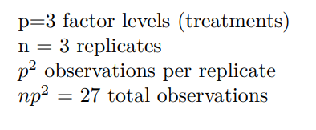
Replicated Latin Square Design - Case 2
Given one factor and two blocks, the Latin Square Design is the most appropriate for our experiment.
We replicate to increase the error degrees of freedom. We chose case 2: column (size) is the same across replicates, task (row) takes new values for each replicate
p = 3 factor levels (treatments)
n = 3 replicates
p^2 observations per replicate
n*p^2 = 27 total observations

Slide 5
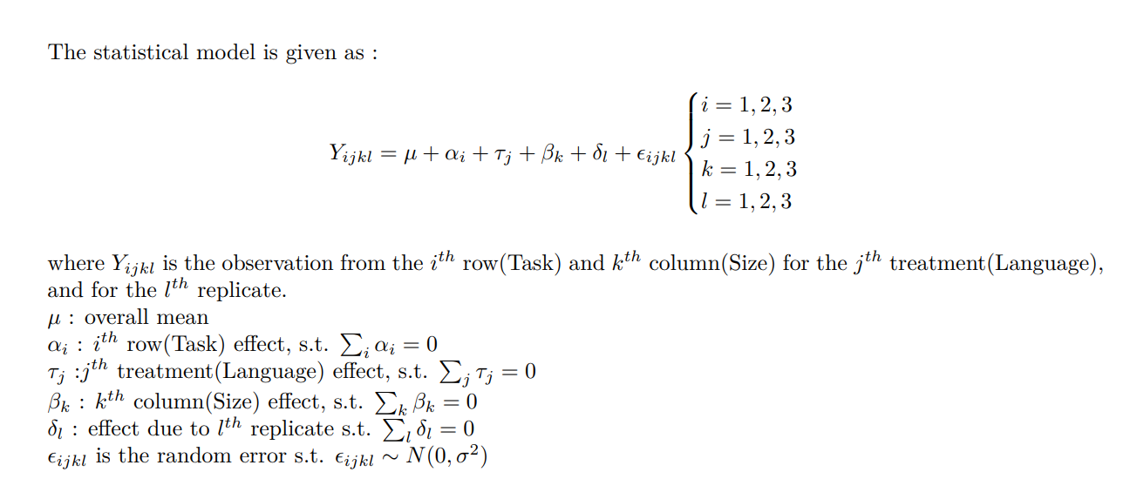
Replicated Latin Square Design - Case 2

Slide 6
Replicate 1 - Original
Size of Data
 | Small | Medium | Large
Simple | Python | R | Matlab
Matrix | R | Matlab | Python
Logistic | Matlab | Python | R
Task

Slide 7
Replicate 2
Size of Data
 | Small | Medium | Large
Logistic | Python | R | Matlab
Simple | R | Matlab | Python
Matrix | Matlab | Python | R
Task

Slide 8
Replicate 3
Size of Data
 | Small | Medium | Large
Matrix | Python | R | Matlab
Simple | R | Matlab | Python
Logistic | Matlab | Python | R
Task

Slide 9
Analysis

Slide 10
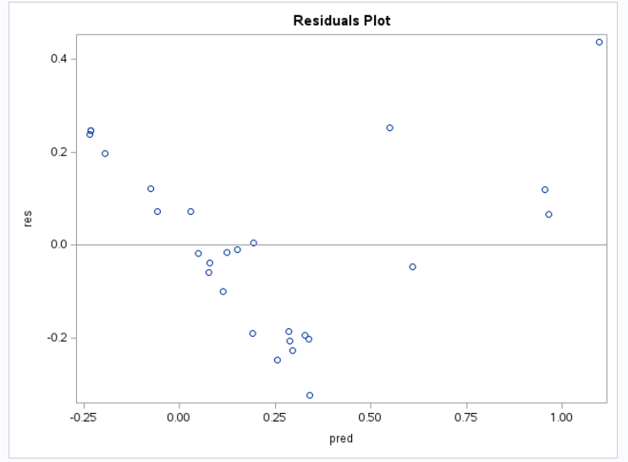
Residuals Plot

Slide 11
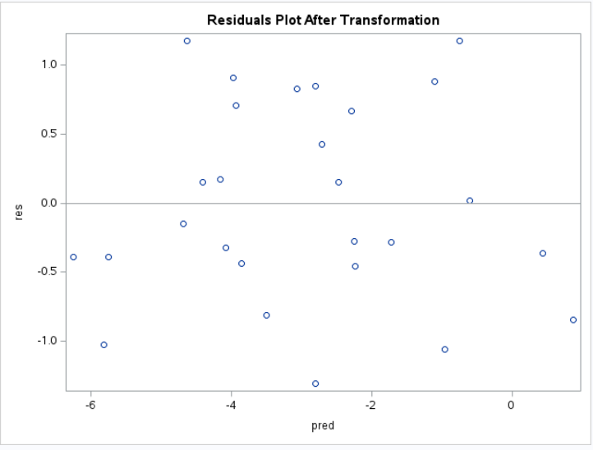

Slide 12
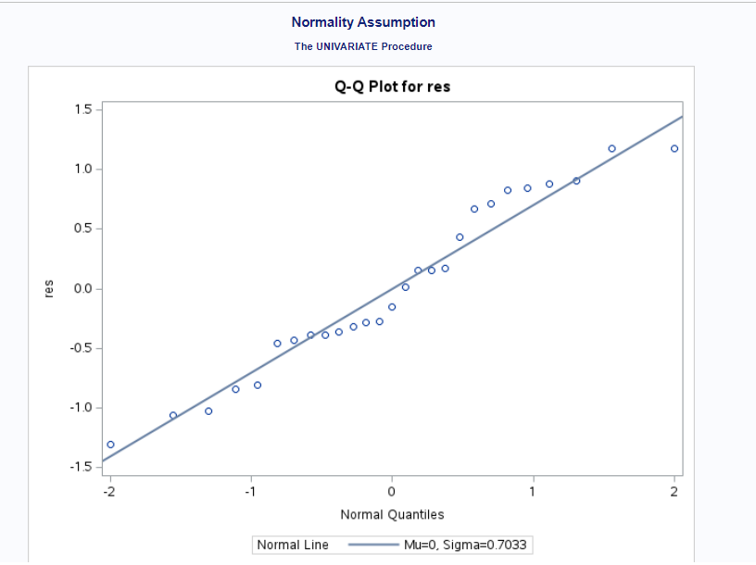
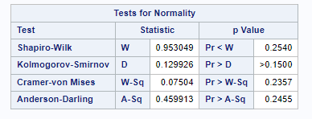
Normality Assumption

Slide 13
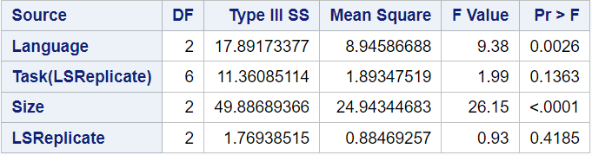
ANOVA Table

Slide 14
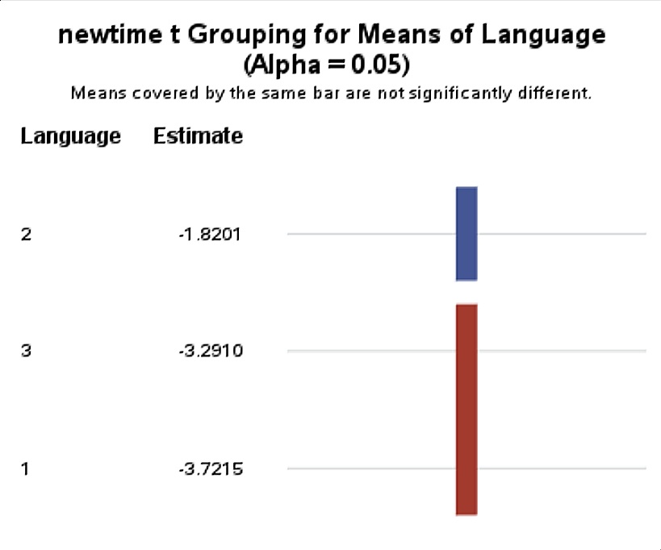
Post ANOVA Comparison
R
Matlab
Python
Notes:
Note that this is

Slide 15
Takeaways
Conclusion: Statistically significant difference between R, and Python and Matlab. Given the runtimes, R is the slowest and Python is the fastest.
Possible improvements:
Focus on one type of task (ie. regression, text analysis, dynamic programming, machine learning, etc.)
Time for data to load plus time for task
Include second factor: memory allocation
Consider energy efficiency for MATLAB/R/Python as in (1)
Pereira, Rui, et al. “Ranking Programming Languages by Energy Efficiency.” Science of Computer Programming, vol. 205, 2021, p. 102609., https://doi.org/10.1016/j.scico.2021.102609.

Slide 16
Questions?

